Slide 1
Lecture 31: Computing with Turing Machine
Agenda:
Formal Definition of TM
Example on Computing with Turing Machine
Presented by
Prof. Vaibhav Narayan Chunekar
K. J. Somaiya College of Engineering, Vidyavihar, Mumbai

Slide 2
Formal Definitions for
Turing Machines
KJSCE

Slide 3



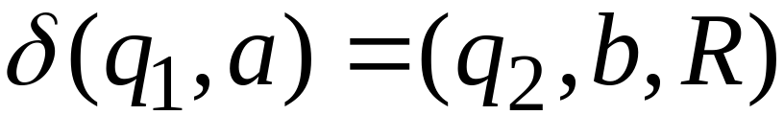
Transition Function
KJSCE

Slide 4

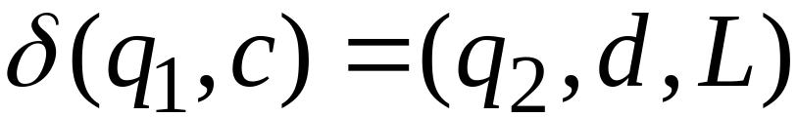
Transition Function
KJSCE

Slide 5
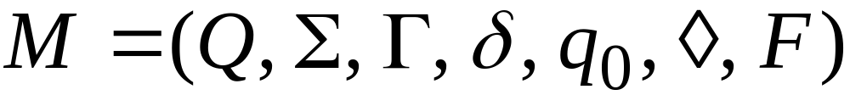
Turing Machine:
Input
alphabet
Tape
alphabet
States
Transition
function
Accept
states
Initial
state
blank
KJSCE

Slide 6




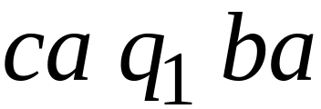
Configuration
Instantaneous description:
KJSCE

Slide 7



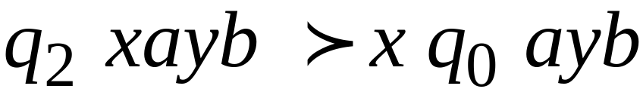
Time 4
Time 5
A Move:
(yields in one mode)
KJSCE

Slide 8
Time 4
Time 5
Time 6
Time 7
A computation
KJSCE

Slide 9
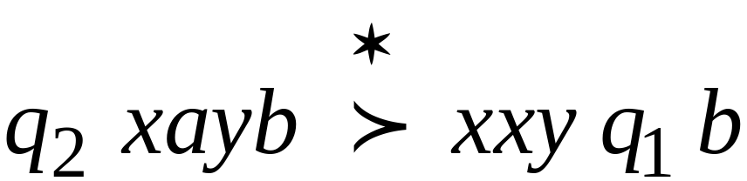
Equivalent notation:
KJSCE

Slide 10
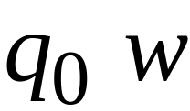

Initial configuration:
Input string
KJSCE

Slide 11

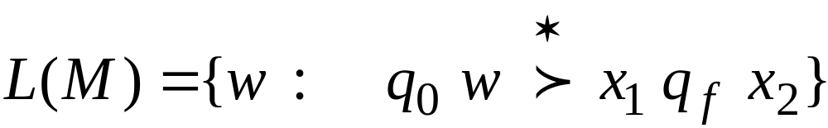
The Accepted Language
For any Turing Machine
Initial state
Accept state
KJSCE

Slide 12


If a language is accepted
by a Turing machine
then we say that is:
Turing Recognizable
Other names used:
Turing Acceptable
Recursively Enumerable
KJSCE

Slide 13
Computing Functions with
Turing Machines
KJSCE

Slide 14
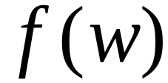


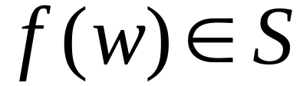

A function
has:
Domain:
Result Region:
KJSCE

Slide 15
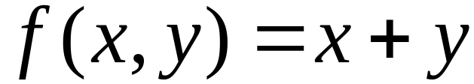
A function may have many parameters:
Example:
Addition function
KJSCE

Slide 16
Integer Domain
Decimal:
5
Binary:
101
Unary:
11111
We prefer unary representation:
easier to manipulate with Turing machines
KJSCE

Slide 17


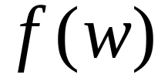

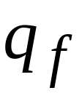
Definition:
A function is computable if
there is a Turing Machine such that:
Initial configuration
Final configuration
initial state
accept state
For all
Domain
KJSCE

Slide 18
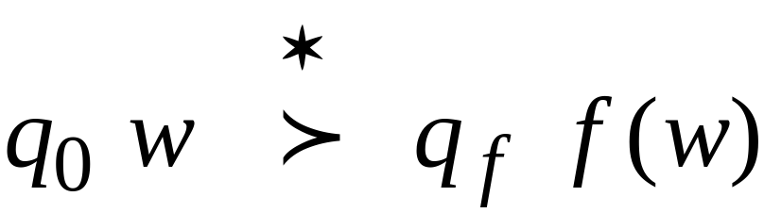
In other words:
A function is computable if
there is a Turing Machine such that:
Initial
Configuration
Final
Configuration
For all
Domain
KJSCE

Slide 19

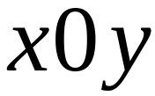
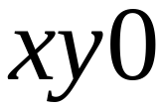
Example
The function
is computable
are integers
Turing Machine:
Input string:
unary
Output string:
unary
KJSCE

Slide 20




Start
initial state
The 0 is the delimiter that
separates the two numbers
KJSCE

Slide 21

Start
initial state
Finish
final state
KJSCE

Slide 22
The 0 here helps when we use
the result for other operations
Finish
final state
KJSCE

Slide 23








Turing machine for function
KJSCE

Slide 24

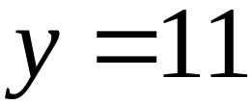
Execution Example:
Time 0
(=2)
(=2)
Final Result
KJSCE

Slide 25
Time 0
KJSCE

Slide 26
Time 1
KJSCE

Slide 27
Time 2
KJSCE

Slide 28
Time 3
KJSCE

Slide 29
Time 4
KJSCE

Slide 30
Time 5
KJSCE

Slide 31
Time 6
KJSCE

Slide 32
Time 7
KJSCE

Slide 33
Time 8
KJSCE

Slide 34
Time 9
KJSCE

Slide 35
Time 10
KJSCE

Slide 36
Time 11
KJSCE

Slide 37
Time 12
HALT & accept
KJSCE

Slide 38
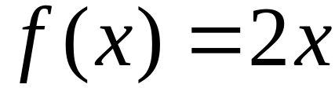

Another Example
The function
is computable
is integer
Turing Machine:
Input string:
unary
Output string:
unary
KJSCE

Slide 39

Start
initial state
Finish
accept state
KJSCE

Slide 40
Turing Machine Pseudocode for
Replace every 1 with $
Repeat:
Find rightmost $, replace it with 1
Go to right end, insert 1
Until no more $ remain
KJSCE

Slide 41
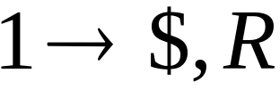
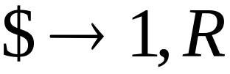

Turing Machine for
KJSCE

Slide 42
Example
Start
Finish
KJSCE

Slide 43


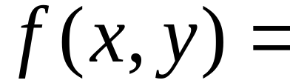

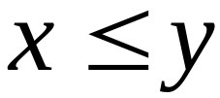
Another Example
if
The function
is computable
if
Input:
Output:
or
KJSCE

Slide 44
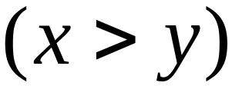
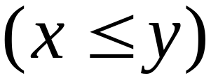
Turing Machine Pseudocode:
Repeat
Match a 1 from with a 1 from
Until all of or is matched
If a 1 from is not matched
erase tape, write 1
else
erase tape, write 0
KJSCE

